Slide 1
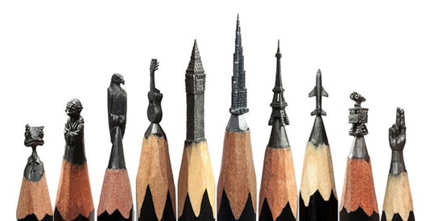
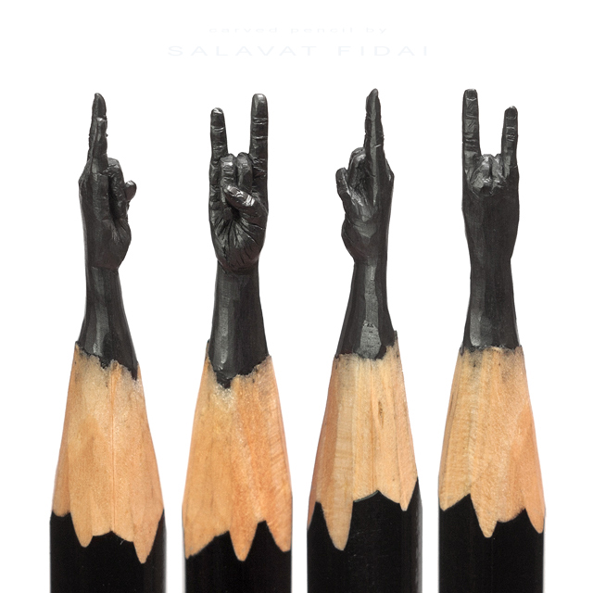
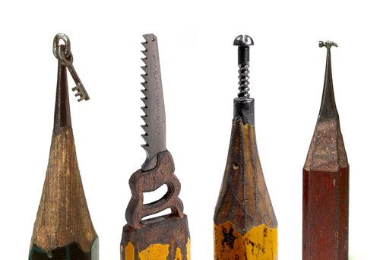
Writing Anchor Papers
Grade 6 Writing Prompts

Slide 2
A-1 CW
I have been asked to share a lesson with elementary school students. first and foremost one of the lesson i would share with the students is math. the main reason why i would share math is because math is pretty easy to learn the main ethic i would share is how to divide the number into the problem. this is one of the main reason why i would share math.

Slide 3
A-10 UM
A lesson I would share with elementary students is to help someone with advice on a problem but not getting involved in the problem. This is a basic skill in life, in order to stay out of trouble but to also be helpful to someone who needs help. Your friend's might like you more for it as well. It's a helpful skill to have and it tends to come in handy on many occasions.
Not getting in trouble is just one benefit to know how to deal with a situation without gettng involved. It is a very beneficial one though. For example if for some reason my friend gets mad at my other friend and they ask me for my opinion on the situation but at different times i'm going to give them my advice that doesn't take any sides. I'm going to say something that'll just make them think to resolve the problem or the fight in order for the conflict to stop and for everything to go back to normal. In that sense me as the friend does not get involved in the situation but actually guides them to a solution while still having them feel i'm not going against their opinion.
Your friend's might appreciate you more because you can help them in the way that you do. You don't offend them or go against them but you give them some reasonable advice to solve the situation. If your friend has been getting into fights with their boyfriend or girlfriend and you know you can give good advice that won't make them feel like they're doing something wrong with their love life but your advice comes to a point where you can get them to try and figure out a solution for the problem and maybe figure out the cause of the fights in order to stop ones that may happen in the future for that same reason. The fights will stop and your friend will thank you and come to you more often because you saved their relationship.
In conclusion because of the skill of being able to help someone without getting involved it will make you a more helpful individual in the future. It may also make you seem and feel like a good caring individual just because you can help in that way.

Slide 4
A-2 CW
Have you wonder what you neighborhood would look like in the future well I want my neighborhood to be a paintball camp I all ways wonder what my neighborhood would look in the future.
I want to live to see my neighborhood turn into a paintball field I never played paintball in my live paint balling seen to be fun you can take your paintball gear to camp and a snack to camp .
you will have to sigh up for paintball camp the place to go to sigh up is 602tippdrive near a the mustang car dealership.
In paintball camp the staff and some help form the pros they will teach how to use the paintball gun and shoot it I will hope to to see you in the future in paintball camp see you in see you later.

Slide 5
A-10 CW
I, as a human being will often credit my success to having a positive attitude. Usually when I have a positive attitude towards something there are benefits. I all ways fell that if you have a positive attitude toward something good or bad it will lead you somewhere in life. When I have a positive attitude, my positive attitude sometimes inspires others to have a positive attitude. I will tell why it is important to have a positive attitude by telling you some of my life experiences.
To begin with, one time I was stranded on an island with four other people, they constantly panic, I told them that we would be fine. For the first few hours they believed me until one guy said, "we will never make it off this island," the rest of them agreed with him and began to panic once more, I told everybody to shut up and that we will make it off this island. I began telling everyone what to gather because I knew that we would not be found that day, but I still kept a positive attitude and did not allow fear to over come me. As I began to wake up I saw a boat, I started yelling, jumping up and down, and waving my arms, but no matter what I did the boat did not see me, and then one girl came behind me and said, "it's useless," but ignored her still kept trying because I knew that we would be found. Hours went by, I noticed that one girl was crying, I went over to her and asked her what was wrong she said, "you know what's wrong, we're going to end up like the others, dead!"
As well as, I try ed keeping a positive thought, but everyone kept acting depressed. I was positive about everything, but the rest of them did not and would not believe me. I try ed telling them that everything would be all right, but they still would not believe me, sometimes I felt hopeless, but I thought about what I said to the others. One morning I woke up to find that some of the stuff that was on the boat was washed up on shore. I started grabbing everything hoping to find food, water, and a radio; I searched for at least an hour before I found a radio, I pressed the on/off switch to see if it worked, which it did, as soon as it turned on I started switching channels making distressed calls hoping someone would get my message.
Although, I kept a positive feeling, it took two weeks before we were rescued. I guess now that I think about it, it was not my patience that saved our lives, it was my positive thinking. I was positive the whole time, but I was also determined to keep my word, that everything would be fine. If it was not for my positive thinking, I would not be here talking to you, nor breathing. I believe you can succeed in anything as long as you are positive.
last, a positive thinker has a good attitude, has a good attitude even when something is difficult, and knows the benefits of being a positive thinker. A positive thinker thinks about the good things that can come out of something. A positive thinker inspires others to think like he or she does. A positive thinker will make it out of a difficult situation. Being a positive thinker will always pay off.

Slide 6
A-8 CW
Most schools in America serve only healthy drinks and beverages. They serve them at breakfast and lunch. Some schools even for dinner such as a night school. I know for a fact they schools that don't are at least trying to serve them as well.
Some of the healthy drinks and beverages that schools are or are trying to serve include milk or orange juice for example. Milk is full of calcium witch builds stronger bones and teeth. Orange juice has a large supply of vitamin C witch the body needs every day. Some other healthy beverages include things like grape juice and apple juice. I know there are many other healthy drinks and beverages out there.
Most of the schools in the United States are starting or trying to serve these healthy drinks and beverages to keep you healthy and strong. Many children are suffering childhood obesity and have a much stronger risk of cancer and diabetes. The drinks I mentioned are very good for the health along with a little bit of exercise they could be even better.
Most schools including my own already do this, but if they don't then they should.There are many drinks that can be served that are better for you than soda or sugar filled drinks. I definitely agree that most of the drinks and beverages schools are serving over all are very healthy. Keep up the good work my fellow communities!

Slide 7
A-5 CW
Do you think it would be better if schools offered nutritious drinks only? Well i think only offering nutritious drink such as white milk,water,and natural fruit juice is a awesome way to make schools healthier, and i think with given healthier options like these can help wake students up and make them ready to learn,and make them more active.
If schools only offered nutritious drinks it would help make the students healthier.If students only had nutritious drinks in schools it could help them make better healthier food choices; Therefore making students more healthy.
Also if the student had more nutritious drinks, that helped them make better healthier food choices it could help students stay awake and be more focused during class.So right after lunch or if they eat breakfast at school then they will be wide a wake and ready to learn.
Last but currently not lest,if schools had more nutritious food and drink options at school it would help them be more active in school and out of school. And helping them make better choices home in school and everywhere.
So now what do you think? do you want your school to have more nutritious foods and drinks ? Because it can help make you healthier,help you wake up and do better in school,and help you be more active,so think about it cause i think it's a grate idea.

Slide 8
A-12 UM
Health matters, but it does not always mean staying in shape. What if the schools only had healthy drinks such as milk, water or natural fruit juices? What about the kids that are lock-tos and tolerate and can't stand milk? What about the kids that have diabetes and need a soda every once and a while? School is about learning, not fitness and health.
If schools only had milk, how is that fair to the kids who don't like it? Schools are all about fairness and respect. Well, kids can't help it if they're lock-tos and tolerate! Some of us are vegetarians and won't drink milk since it comes from a cow. Some kids don't like how thick it is, or the way it smells! And then there are some kids who just don't like the taste. You can't force a drink on us if we don't like it!
There are some diabetic students in our schools. Although they can't always have sugar and caffeine like other students, they need something with sugar in it when their blood pressure lowers! Milk nor water has sugar in it. So how would that help a student in need? Sodas are not healthy, but they help kids higher their blood pressure when it drops! Serving sodas at school is not a bad idea.
You would think fruit juices are healthy and good for you. But to get it to taste good, you have to add tons of sugar to it! Then they're just as bad for you as sodas are! Some have too much sugar and taste disgusting! Some have too little sugar and taste horrible as well! A lot of them have that thick tangy taste to it. There is no possible way that could be healthy for you!
Water is good for your health, i agree with that. It has no calories or fat in it! But it also has no flavor or taste to it! No normal student in their right mind would buy a flavorless drink and waste their money! They schools would be wasting their money providing it, if no one is going to buy it!
The point i'm trying to make here, is if schools sold sodas, they would make a profit off of it! Students want sodas, give it to them, not healthy drinks that most students don't care about! Let us worry about health outside of school.

Slide 9
A-13 CW
Ca ching! That is the sound of millions of dollars going into Messi's, a famous soccer player, bank account. While other people are unemployed, he, other professional athletes, and entertainers make millions of dollars a year. I do not agree that professional athletes and entertainers should earn large sums of money because America is in an economic crisis, they do not teach Americans valuable lessons, and also the money could be used for medical research.
I feel that professional athletes and entertainers should not earn large sums of money because we are in an economic crisis. Since we are in an economic crisis, why should men playing football get paid more that an average American that works at a real job helping Americans? Also, while the professional athletes and entertainers are getting paid large sums of money, lots of Americans are out of work, and if some of the money that professional athletes and entertainers went to businesses instead of the money going to the entertainment of Americans we might have more Americans employed. Another reason is the millions of dollars that professional athletes and entertainers are paid a year could be put into charities to help feed poor Americans. Consequently, that is why the money that professional athletes and entertainers earn should not be as much because of America's economic crisis.
I also feel that professional athletes and entertainers should not earn large sums of money because they do not teach Americans valuable lessons. The professional athletes do not teach us or protect us like the way a teacher would or a policeman and a firefighter. Professional athletes earn high sums of money for playing a sport for a short period maybe a few times a week, whereas a teacher works practically everyday for very little pay and teaches children information they will need to know when they grow up. Entertainers may teach us what type of clothing is in or out, but entertainers do not teach us valuable life long lessons. This is another reason why professional athletes and entertainers should not earn big sums of money because they do not teach Americans valuable lessons that they could use everyday.
Another reason that professional athletes and entertainers should not earn large sums of money is the money could be used to help Americans by using the money for medical research. Lots of Americans get diseases that we know what they are, but doctors can't prevent just slow down and with all the money that professional athletes and entertainers make, it could be a big help for research for these diseases. The money could also be used for researching diseases that are rare but there is no cure or any medicine to prevent the disease. Another way the money could be used for research is to find better cures. Using the large sums of money that professional athletes earn this way could be more beneficial to the American public than trying to entertain them.
These are the reasons why I do not agree that professional athletes and entertainers should earn large sums of money. I feel that the money that they earn could be greatly used now because of our economic crisis. Also, Americans do not learn important data from professional athletes and entertainers. Lastly, the money that professional athletes and entertainers earn could be used to help Americans be prevented from many diseases. All in all, I do not agree that professional athletes and entertainers should not earn large sums of money.

Slide 10
Key
A-1 CW 1
A-10 UM 3
A-2 CW 1
A-10 CW 3
A-8 CW 3
A-5 CW 2
A-12 UM 4
A-13 CW 4

